Slide 1




Information Marketplace for Policy and Analysis of Cyber-risk & Trust
Program Manager:
Erin Kenneally, M.F.S., J.D.
Cyber Security Division
Driving Trusted Data & Analytics
Notes:
Value can be ascribed to Scarcity, the lack of quality data for cybersecurity R&D fits that criteria
Need for real world data for devlpmt, testing, evaluation of cybersecurity theories, techniques, products.
- Trust and transparency are the economic enablers in the information age

Slide 2
IMPACT Motivation: The ‘Open Secret’ of Effective R&D
Data are critical to R&D capabilities
Exactly 0% of R&D (quality) possible sans data
Cybersecurity needs real-world data to develop, test, evaluate knowledge & tech solutions to counter cyber threats
“Big Data” may grow on trees but still has to be picked, sorted, trucked
Decision analytics are critical to Govt and Industry capabilities
Cybersecurity needs integrated, holistic understanding of risk environment
Gap between Data <-->Decisions: multi-dimensional, complex association and fusion, high-context presentation elements
Data sharing + Analytics != Easy
High value data = High legal risk + $$
Data rich vs. data poor
Expensive to abstract away low level knowledge- and labor- intensive tasks
Technologists optimize for Efficiency, Lawyers optimize for Certainty
Notes:
Need for real world data for devlpmt, testing, evaluation of cybyersecurity theories, techniques, products.
Data are critical to R&D capabilities
Exactly 0% of R&D possible sans data
Cybersecurity needs real-world data to develop, test, evaluate knowledge & tech solutions to counter cyber threats
“Big Data” may grow on trees but still has to be picked, sorted, trucked
Decision analytics are critical to HSE capabilities
Cybersecurity needs integrated, holistic understanding of risk environment for strategic interventions
Gap between Data and Decisions: multi-dimensional data, complex association and fusion, high-context presentation elements
Data sharing + Analytics |= Easy
High value data = High legal risk + $$
Data rich vs. data poor
Expensive to abstract away low level knowledge- and labor- intensive tasks
Technologists optimize for Efficiency, Lawyers optimize for Certainty
Market need:
Existing capabilities do not provide necessary cyber risk decision analytic support needed by HSE
Dynamic cyber security R&D to support changing risk environment
Product:
1st-gen R&D-enabling infrastructure democratized data raw materials (Data Providers)
New BAA fosters evolved R&D infrastructure adds derivative data products and tools for HSE

Slide 3
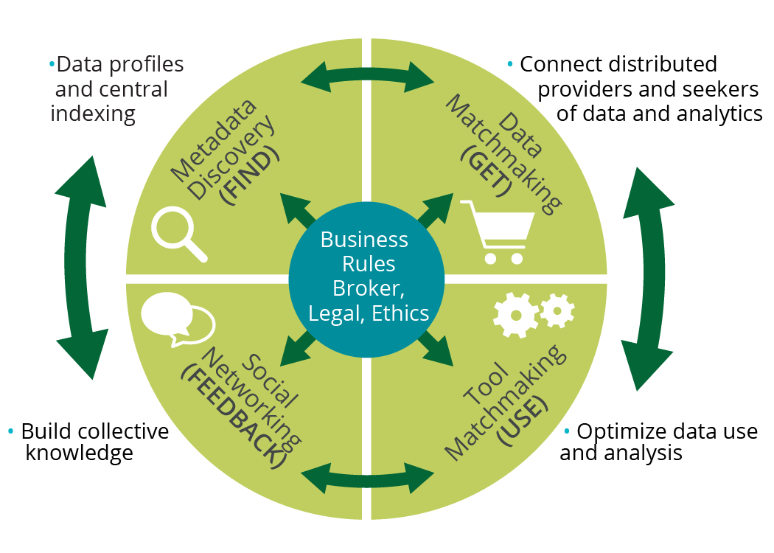
Notes:
Need for real world data for devlpmt, testing, evaluation of cybyersecurity theories, techniques, products.
Data are critical to R&D capabilities
Exactly 0% of R&D possible sans data
Cybersecurity needs real-world data to develop, test, evaluate knowledge & tech solutions to counter cyber threats
“Big Data” may grow on trees but still has to be picked, sorted, trucked
Decision analytics are critical to HSE capabilities
Cybersecurity needs integrated, holistic understanding of risk environment for strategic interventions
Gap between Data and Decisions: multi-dimensional data, complex association and fusion, high-context presentation elements
Data sharing + Analytics |= Easy
High value data = High legal risk + $$
Data rich vs. data poor
Expensive to abstract away low level knowledge- and labor- intensive tasks
Technologists optimize for Efficiency, Lawyers optimize for Certainty
Market need:
Existing capabilities do not provide necessary cyber risk decision analytic support needed by HSE
Dynamic cyber security R&D to support changing risk environment
Product:
1st-gen R&D-enabling infrastructure democratized data raw materials (Data Providers)
New BAA fosters evolved R&D infrastructure adds derivative data products and tools for HSE

Slide 4

Shop til You Drop IMPACT Portal ImpactCyberTrust.org

Slide 5

Data Trends
Source: DHS IMPACT program; SRI analysis, Dec ‘18
No Data in 2007

Slide 6
Customers & Stakeholders
IMPACT customer base encompasses cyber security researchers and developers in 8 partner countries: AUS, CAN, UK, JA, NL, Israel, Singapore
New Zealand, Ireland, Spain, Sweden, Germany, South Africa, Denmark, South Korea all eager to participate. Will onboard under new model pending program’s future.

Slide 7
Model- Ahead of its Time
Current method to de-risk data sharing
How IMPACT addresses risks
Engage in a rigorous internal review of proposed academic research projects.
Close to half of the companies retain custody and control over the research data at all times.
Companies employ rigorous data use agreements to limit access to and use of shared data.
Lots of lawyers
Easier not to play
✔️
✔️
✔️
Vet Researchers, Providers, Data
Provider can host and provision own data
Provider can engage Disclosure Control-as-a-Service for very sensitive data that allows analysis without Researcher seeing data
Provider leverages standardized Researcher data use agreements with customized additional restrictions by Provider
2018 Kenneally

Slide 8









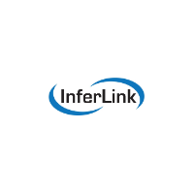


Current Booths in the Marketplace
Decision Analytics-as-a-Service Provider Network
David Archer
Suresh Krishnaswamy
Julian Goldman
Mediator Infrastructure
Nicolas Christin
Steve Minton
Dustin Henson
John Heidemann &
Christos Papadopolous
MooreTyler
Alberto Dainotti
& kc Claffy
Paul Royal
Paul Barford
JASAdvisors
Jeff Schmidt
Data Provider Network
Notes:
Blackfire
CAIDA
USC-ISI/Colorado State
University of Tulsa
Parsons
Mass General
Inferlink
Georgia Tech
JSA Advisors (no working logo)
University of Wisconsin
Carnegie Mellon University
Galois

Slide 9
Data Popularity (2015-18)
Dataset Name | Data Provider
GT Malware Passive DNS Data Daily Feed | Georgia Tech
Historical GT Malware Passive DNS Data 2011-2013 | Georgia Tech
US Long-haul Infrastructure Topology | University of Wisconsin
DARPA Scalable Network Monitoring (SNM) Program Traffic | DARPA
Skaion 2006 IARPA Dataset | SKAION
GT Malware Unsolicited Email Daily Feed | Georgia Tech
DSHIELD Logs | University of Wisconsin
syn-flood-attack | Merit Network, Inc.
Netflow-1 | Merit Network, Inc.
DoS_traces-20020629 | University of Southern California-Information Sciences Institute
NCCDC 2013 | Center for Infrastructure Assurance and Security (UTSA/CIAS)
NCCDC 2014 | Center for Infrastructure Assurance and Security (UTSA/CIAS)
DoS_80_timeseries-20020629 | University of Southern California-Information Sciences Institute
CAIDA DDoS 2007 Attack Dataset | UCSD - Center for Applied Internet Data Analysis
Netflow-2 | Merit Network, Inc.
Netflow-3 | Merit Network, Inc.
NCCDC 2011 | Center for Infrastructure Assurance and Security (UTSA/CIAS)
NTP DDoS 2014 | Merit Network, Inc.
NCCDC 2015 | Center for Infrastructure Assurance and Security (UTSA/CIAS)
UCSD Real-time Network Telescope Data | UCSD - Center for Applied Internet Data Analysis

Slide 10


Introducing: The ORDINAL Dataset
Operational Research Data from Internet NAmespace Logs

Slide 11
DNS Namespace Collisions: a (very) quick history
As old as the DNS itself
Researched since ~2003
New interest related to ICANN’s new gTLD Program
Result when resolving party is other than the one anticipated
“Squatting” and “drop catching” seek to leverage collisions
Machine-to-machine traffic is more interesting
Exacerbated by complex/aggressive DNS search path processing
Misuse of the DNS for Authentication

Slide 12
(known) Violators that Misuse the DNS for Authentication (1)
Protocols/Applications that lack server authentication
Server authentication is hard, think https/tls/x.509, and ssh
Especially in scenarios where there is no pre-existing trust
Legacy protocols (FTP, POP, etc) mostly punt
SMTP
Identification by DNS MX record; no cryptographic authentication
Few use SMTP over TLS to add cryptographic authentication (used for transport)
Most email honeypots leverage this behavior

Slide 13
(known) Violators that Misuse the DNS for Authentication (2)
Microsoft Active Directory, SMB/CIFS
Active Directory namespaces are DNS namespaces
Locates URL/UNC resources via DNS; trusts the response (!!)
\\SYSVOL, \\NETLOGON (!!)
\\users\jschmidt and smb://users/jschmidt
SMB/CIFS will downgrade to WebDAV over http (SharePoint) (!!)
Crux of JASBUG/CVE-2015-0008/MS15-011,014
Trivially exploitable (Responder and SMBRelay)
Microsoft’s response, SMB Signing, adds cryptographic authentication
"PROPFIND /USERS/michaelw HTTP/1.1" 405 240 "-" "Microsoft-WebDAV-MiniRedir/10.0.10586"
"PROPFIND /SYSVOL/XXX/Policies/%7B87DF. . . 48FA9EC%7D HTTP/1.1" 405 293 "-" "Microsoft-WebDAV-MiniRedir/6.1.7601"

Slide 14
(known) Violators that Misuse the DNS for Authentication (3)
Microsoft Distributed File System (DFS)
DFS Namespaces are DNS Namespaces
"PROPFIND /DFSRoot02/05_0139/10_General/30_Communication/02_Management_People/info%20in%20verband%20met%20nieuwe%20CAT%20systeem%20in%20EMS HTTP/1.1" 405 338 "-" "Microsoft-WebDAV-MiniRedir/6.1.7601"
WPAD
http://wpad.microsoft.com/wpad.dat (and iterations/subdomains)
No authentication; very bad; trivially exploitable (Responder has a module)
"GET /wpad.dat HTTP/1.1" 404 206 "-" "WinHttp-Autoproxy-Service/5.1"

Slide 15
(known) Violators that Misuse the DNS for Authentication (4)
Microsoft System Center Configuration Manager (SCCM)
Formerly Systems Management Server (SMS); widely deployed
Uses http and custom method: CCM_POST
No discernable server authentication
"CCM_POST /ccm_system/request HTTP/1.1" 501 214 "-" "ccmhttp”
"GET /SMS_MP/.sms_aut?SITESIGNCERT HTTP/1.1" 404 213 "-" "SMS CCM 5.0”
"HEAD /SMS_DP_SMSPKG$/4885f087-977b-4a79-b1b6-e4370a25492c HTTP/1.1" 404 - "-" "SMS CCM 5.0"
Microsoft “OutlookAnywhere”
Uses http and custom methods: RPC_IN_DATA, RPC_OUT_DATA
"RPC_IN_DATA /rpc/rpcproxy.dll?d89b673c-38b0-483c-b906-89e992c88c12@XXX.com:6001 HTTP/1.1" 501 215 "-" "MSRPC”
"RPC_OUT_DATA /rpc/rpcproxy.dll?d89b673c-38b0-483c-b906-89e992c88c12@XXX.com:6001 HTTP/1.1" 501 216 "-" "MSRPC”
No discernable server authentication

Slide 16
(known) Violators that Misuse the DNS for Authentication (5)
Other/Custom Applications
"GET /system/transSession.asp?loginusername=KylieXXX&ucomp=01&sysname=E-Freight%20Payment%20System HTTP/1.1" 404 221 "http://epayment.XXX.corp.com/system/login.aspx" "Mozilla/5.0 (Windows NT 6.1; WOW64) AppleWebKit/537.36 (KHTML, like Gecko) Chrome/45.0.2454.101 Safari/537.36”
"GET /sm_login/sm_login.asp?user-id=phemingXXX&password=<muchsadness>&ismd5=1&app-id=cmwin.19.45.1602.0&timeout=30 HTTP/1.1" 404 219 "-" "-”

Slide 17
(known) Violators that Misuse the DNS for Authentication (6)
Just plain Evil
"PROPFIND /SysVol/XXX.corp.com/scripts/IR/IRD/ChangePassword.vbs HTTP/1.1" 405 275 "-" "Microsoft-WebDAV-MiniRedir/6.1.7600”
"PROPFIND /it/Installs/Work%20Station/Standard%20Applications/GPINSTALL/Local%20Admin%20Password%20Change HTTP/1.1" 405 310 "-”
"PROPFIND /home/deebXXX/passwords/keepass HTTP/1.1" 405 257 "-”
"GET /Citrix/XenApp/site/changepassword.aspx HTTP/1.1" 404 236 "-" "Mozilla/5.0 (iPhone; CPU iPhone OS 7_0 like Mac OS X)
“PROPFIND /Wallpaper/SCREENSAVER.jpg HTTP/1.1 "-”

Slide 18
What is in the ORDINAL Dataset
CORP.COM
02PROXY.COM
ANAMS1.COM
ANAMS2.COM
ANAMS3.COM
ANAMS4.COM
ANAMS5.COM
ANAMS6.COM
DEFAULT-FIRST-SITE-NAME.COM
IISPROXY.COM
LVFS1-2K.COM
OAUTHPROXY.COM
SIPEXTERNAL.NET
SIPINTERNAL.NET
VLAN01.COM
VLAN101.COM
VLAN141.COM
VLAN142.COM
VLAN143.COM
VLAN144.COM
VLAN145.COM
VLAN400.COM
VLAN403.COM
VLAN404.COM
VLANB.COM
WNADROOT.COM
(And There’s More!)

Slide 19
DNS Search Path ala Microsoft
“Devolution is a Windows DNS client feature. Devolution is the process by which Windows DNS clients resolve DNS queries for single-label unqualified hostnames. Queries are constructed by appending PDS to the hostname. The query is retried by systematically removing the left-most label in the PDS until the hostname + remaining PDS resolves or only two labels remain in the stripped PDS. For example, Windows clients looking for "Single-label" in the western.corp.contoso.co.us domain will progressively query Single-label.western.corp.contoso.co.us, Single-label.corp.contoso.co.us, Single-label.contoso.co.us, and then Single-label.co.us until it finds a system that resolves. This process is referred to as devolution.”
- Microsoft
(https://technet.microsoft.com/library/security/971888)

Slide 20
Why some names (corp.com) are special
Microsoft long ago suggested folks name Active Directories “CORP”
AD hosts and resources have DNS records : <stuff>.corp
SRV qnames we see at corp.com (among millions of others):
_kerberos._tcp.dc._msdcs.Fareast.Microsoft.corp.com
_kerberos._tcp.dc._msdcs.redmond.microsoft.corp.com
_kerberos._tcp.NA-WA-EXCH._sites.dc._msdcs.Fareast.Microsoft.corp.com
_kerberos._tcp.NA-WA-RED._sites.dc._msdcs.redmond.microsoft.corp.com
_ldap._tcp.dc._msdcs.middleeast.microsoft.corp.com
_ldap._tcp.dc._msdcs.redmond.microsoft.corp.com
_ldap._tcp.microsoft.corp.com
_ldap._tcp.NA-WA-RED._sites.microsoft.corp.com

Slide 21
More qnames we actually see at corp.com (just for fun)
wpad.partners.microsoft.corp.com
wpad.redmond.microsoft.corp.com
xboxcontroltower.microsoft.corp.com
isatap.redmond.microsoft.corp.com
itgproxy.northamerica.microsoft.corp.com
itgproxy.redmond.microsoft.corp.com
LUCIS-CXXX.redmond.microsoft.corp.com
UnifiedSearchCube.partners.microsoft.corp.com

Slide 22
Data we collect
Currently available in ORDINAL:
Anonymized DNS querylogs (named logs)
Collected and may be made available on a case-by-case basis:
Email metadata (verbose Postfix logs)
Email delivered to the domain (maildir/ format)
Port 80 and 443 requests (httpd log)
pcaps
IPv4 and IPv6 served here
Open to running experiments (based on risk assessment)

Slide 23
A few stats… one month in 2018
Unique v4 IP addresses sending DNS queries to corp.com authoritative DNS nameservers | 182,612 (Mainly from large recursives)
Unique v4 IP addresses requesting WPAD configurations from the HTTP server hosted at corp.com | 379,403 (IPs of specific end machines received over HTTP)
Unique v4 IP addresses requesting information from the HTTP/WebDAV server hosted at corp.com related to NETLOGON or SYSVOL – the most dangerous items as described in MS15- 011/014 | 75,272 (IPs of specific end machines received over HTTP)
Unique v4 IP addresses requesting information from the HTTP/WebDAV server hosted at corp.com related to USERS – home directory file system mounts | 27,051 (IPs of specific end machines received over HTTP)
Unique v4 IP addresses sending ns1.labs.jasadvisors.com unsolicited DNS UPDATE queries | 140,643 (Mainly IPs specific Microsoft Active Directory Member Machines taken off-site)

Slide 24
ORDINAL Day In The Life (2018-01-10)
count(*) where sld = 'corp.com’: 2,877,118
count(distinct (qname,clientip)) where sld = 'corp.com’: 1,206,480
Top 5 clients by query count:
203.167.x.x 19,126
213.170.x.x 14,513
67.216.x.x 13,119
41.169.x.x 10,657
213.170.x.x 10,576
Takeaway: Not isolated to a few misconfigured clients

Slide 25
ORDINAL Day In The Life (2018-01-10)
All 5 RIRs are represented:
apnic, arin, ripencc, afrinic, lacnic
Top 5 netblocks:
74.125.0.0/16 254,069
69.240.0.0/12 209,777
2001:1890::/29 166,144 ← We see quite a bit of IPv6
76.96.0.0/11 110,891
173.194.0.0/16 82,381
Takeaway: Not isolated to a few (English-speaking) geographies

Slide 26
ORDINAL Day In The Life (2018-01-10)
Top 5 qnames into corp.com:
wpad.corp.com 83,607 ← Known vulnerable
corp.com 76,109 ← Active Directory related (rr=SRV)
srv.corp.com 70,160 ← Active Directory related
null.corp.com 23,742 ← ?
_ldap._tcp.dc._msdcs.corp.com 18,226 ← Active Directory related
msoid.corp.com 11,152 ← Active Directory related
_kerberos._tcp.dc._msdcs.corp.com 11,033 ← Active Directory related
Takeaway: Mostly related to Microsoft technologies

Slide 27
ORDINAL Day In The Life (2018-01-10)
count(distinct (qname,clientip)) where qname like '%wpad%’: 28,488
count(distinct (qname,asn)) where qname like '%wpad%’: 2,383
count(distinct (qname,netblock)) where qname like '%wpad%’: 5,058
count(distinct (qname,netblock)) where qname like '%apple%’: 315
count(distinct qname) where qname like '%microsoft%’: 28 ☺
count(distinct qname) where qname like '%china%’: 19

Slide 28
Thank You!
For More Information:
IMPACT Program ORDINAL Dataset
http:// ImpactCyberTrust.org Search in IMPACT Portal
Program Manager: http://ordinal.jasadvisors.com
Erin Kenneally, M.F.S., J.D. jschmidt@jasadvisors.com
DHS Cyber Security Division

